Slide 1
Attacking NNs with Adversarial Examples
IST 707
Name: Adesh Gadge

Slide 2
Contents
A. Attacking a network with adversarial example
B. Attacks Examples
C. Knowledge of attacker
D. Safety Measures

Slide 3
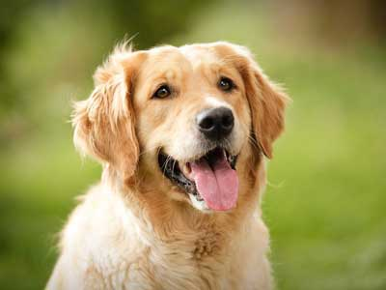
A. Attacking a network with adversarial example
Goal: Given pre-trained model on ImageNet, finding an image that is not a iguana but will be classified as iguana
0.04
..
..
0.02
0.07
..
0.81
..
0.07
“car”
“bus”
“plane”
“dog”
“catfish”
Neural Network Pretrained on ImageNet

Slide 4


A. Attacking a network with adversarial example
Goal: Given pre-trained model on ImageNet, finding an image that is not a iguana but will be classified as iguana
0.04
0.89
..
0.21
0.11
..
0.01
..
0.07
“car”
“iguana”
“bus”
“plane”
“dog”
“catfish”
X
Neural Network Pretrained on ImageNet
0.04
0
..
0
0
..
1
..
0.07
“car”
“bus”
“plane”
“iguana”
(1) Rephrase Problem Mathematically: y_hat(x)=
(2) Loss Function:
(3) Optimization :
X
Network
L
$L\left(ŷ,y\right)=\frac{1}{2} ||ŷ\left(W,b,x\right)−yiguana||$²₂
x =x – $α \frac{∂L}{∂x}$
?

Slide 5
Do you think image will look like Iguana?
S
Space of images classified as Iguana
Space of the all possible images
Space of images of real images

Slide 6
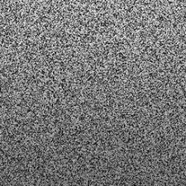

Slide 7
Attacks Examples
Social Media – Violent media
Self driving cars
Face recognition
Changing digits on checks

Slide 8

Make it look like a dog?
0.04
0.001
..
0.03
0.01
..
0.89
..
0.07
“car”
“bus”
“plane”
“iguana”
X
Neural Network Pretrained on ImageNet
Optimization :
Loss Function:
X
Network
L
$L\left(ŷ,y\right)=\frac{1}{2} ||ŷ\left(W,b,x\right)−yiguana||$²₂ $− ƛ||x−xdog||\text{2}\text{2}$
x =x – $α \frac{∂L}{∂x}$
?

Slide 9
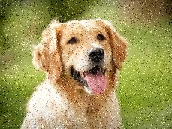

Slide 10
Knowledge of the attacker
White box – We have access to the network layers ( Like we did! )
Black box –
Query the model as many times: We don’t have access to layers (Use numerical Gradient)
Can’t query the model: Adversarial examples are highly transferrable

Slide 11
Safety Measures
Create SafetyNet
Ensemble Models
Train on correctly labelled adversarial examples

